Slide 1

Website Design & Development 010202122 Name: Heba Hanandeh
ID: 18110060
Instructor: Dr. Jalal Kiswani

Slide 2

Introduction
In the beginning, I was asked by the Ministry of Education to design a distinctive website that serves their job business and facilitates the automation of the business so that all of them become electronic rather than paper and certainly reduce the problems they face.

Slide 3

Server
To host and manage websites we need an infrastructure hosted server. There are many application servers available on the market that can be open source like Apache web server. Therefore, to host a website, you need to publish the code on the application server and then the site can be hosted. To manage websites, you can use proxy servers like Nginx or even load balancer to direct equal traffic to the application server.

Slide 4

DNS
DNS is the domain name system, and each organization has a unique domain name, so what DNS does is it resolves the host name to an IP address and vice versa. When you click www.google.com, you don't know the actual google IP address, but the DNS servers have information about Google's IP address, so it will resolve the Google host name and direct traffic to the google server IP address.

Slide 5

The purpose of DNS
(Domain Name System) it invented in 1984 It relies on IP address and domain name, it arranges the naming for computers or services and resources, links information with custom domain names and translates it as the domain name meaningful (binary) related to network equipment, processing, and location worldwide

Slide 6

Function of DNS:
for each site name (domain name or URL: resource locator) and IP address. An IP address consists of four groups of numbers separated by periods (Ipv4). When you open a web browser and enter the site name, the browser will go directly to the website without having to enter the website's IP address. The process of "translating" the domain name into an IP address to allow the browser to understand and access the site is the job of the DNS server. DNS goes back and forth to translate the "IP" address into "name" and vice versa. Users only need to remember "names", no need to remember IP addresses (IP addresses are hard numbers to remember).

Slide 7

How DNS work
How DNS work -Each service supplier operates and maintains its own DNS server, together with machines inside a part of that service supplier within the web. That is, if a browser searches the address of an internet site, the DNS server resolves the name of this web site to be the DNS server of the organization that manages the web site, not of any organization (service provider).

Slide 8
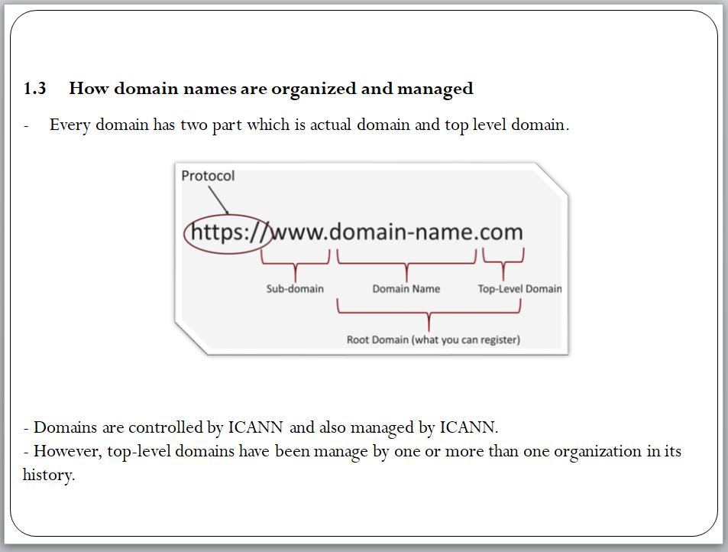
How to manage a domain name
The organization and management of domain names is through (ICANN)Parts of the domain:
1) The domain of the higher level is managed by an institution or more in its history
2) an actual field

Slide 9
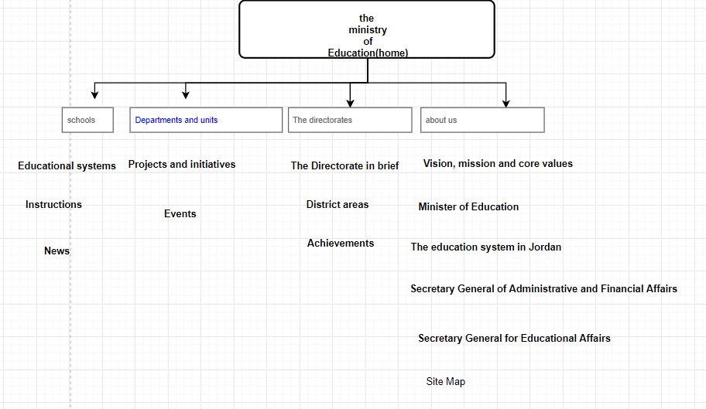
Sitemap

Slide 10
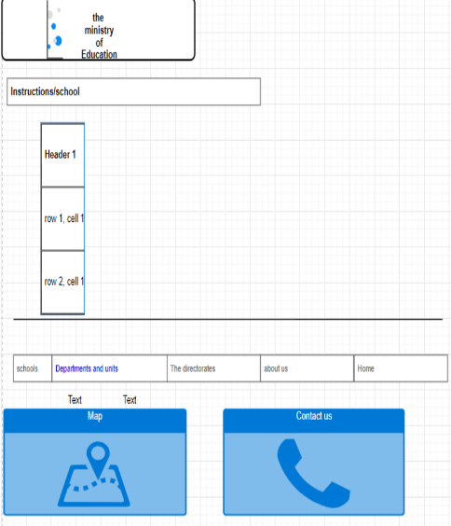
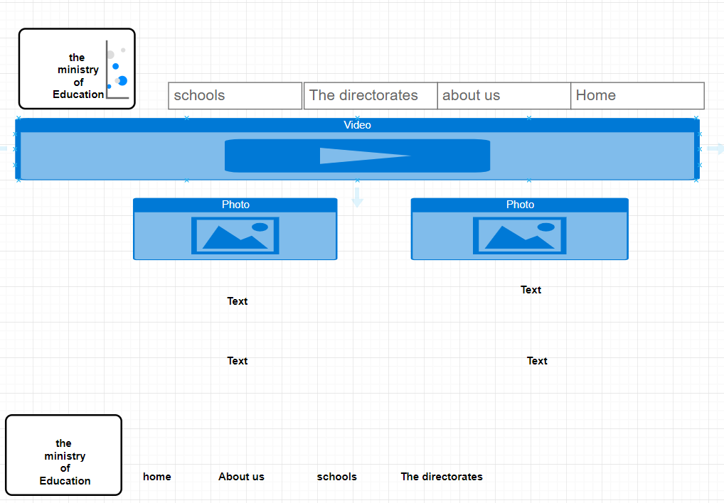
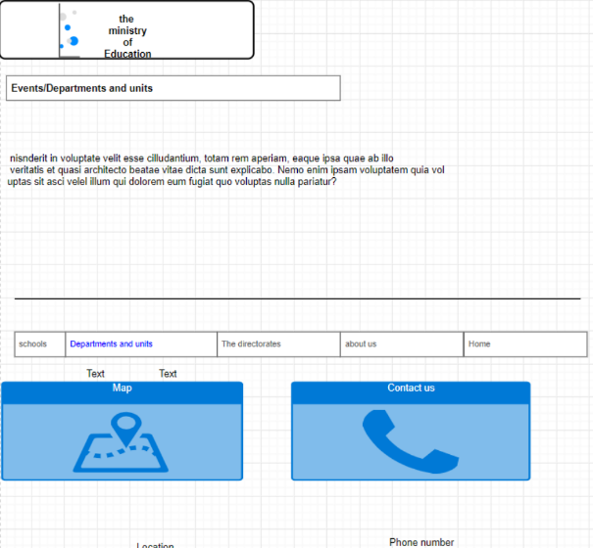
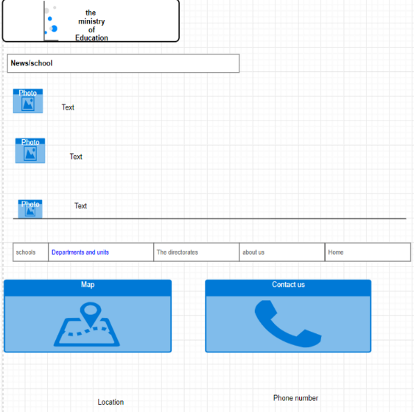
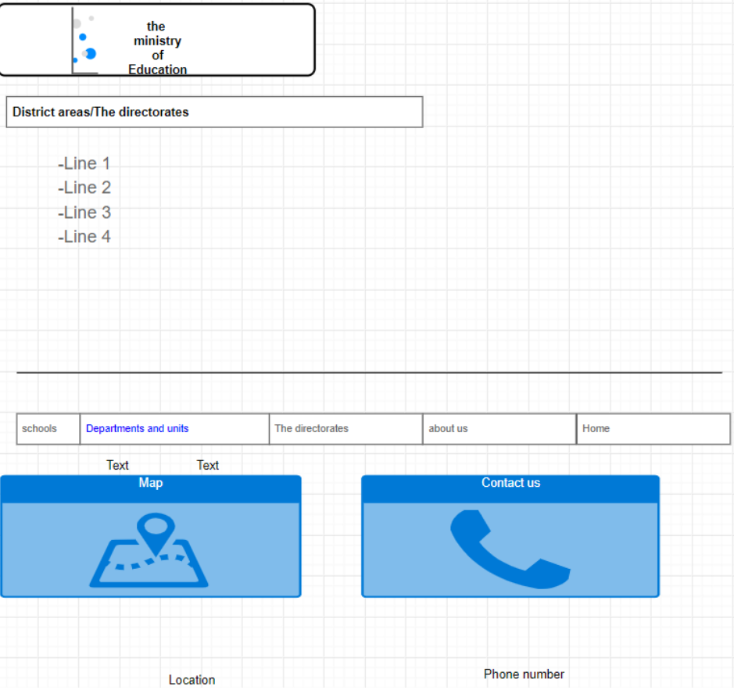
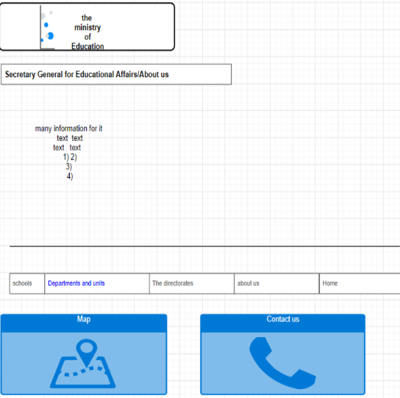
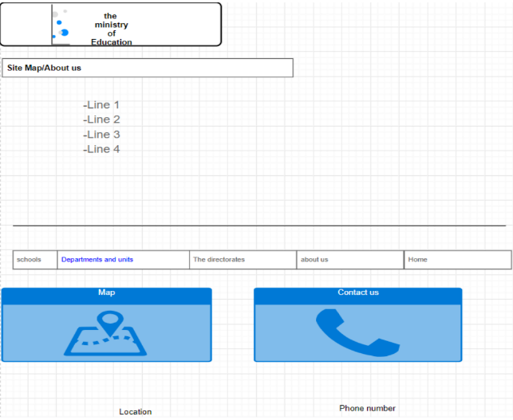
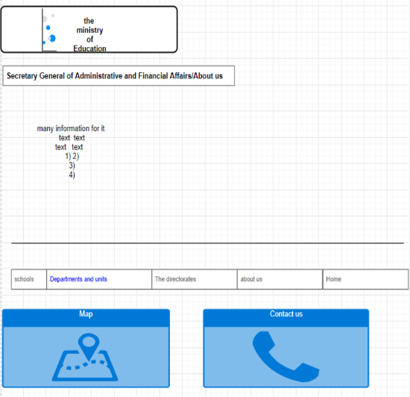
mockup-wierframe

Slide 11
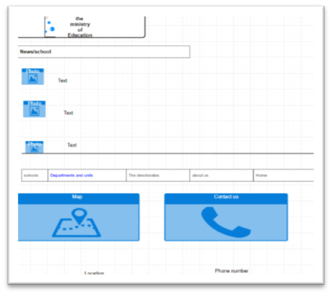
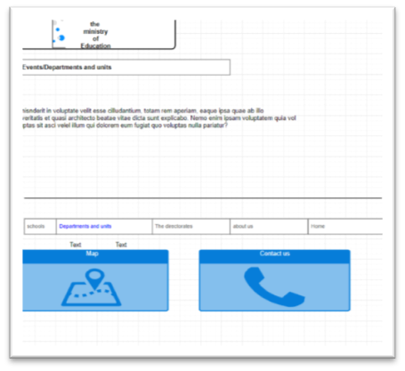
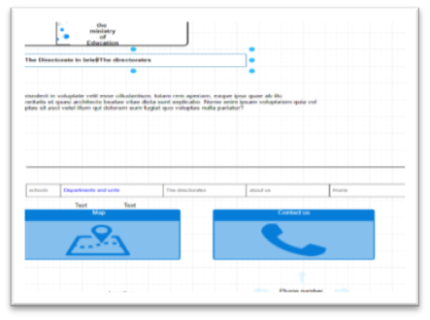
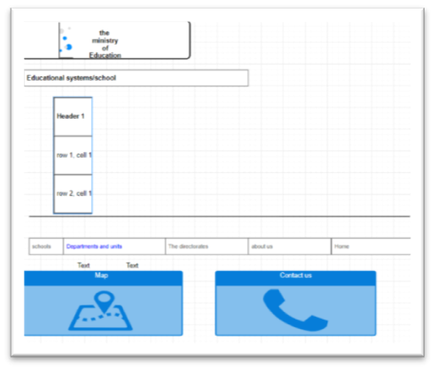
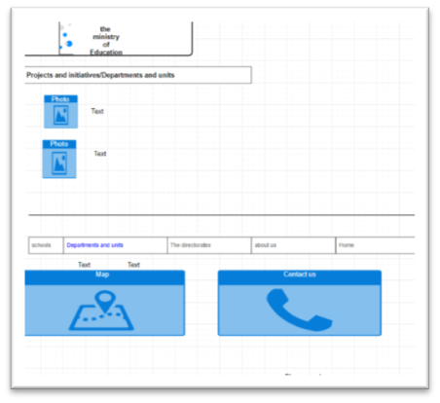
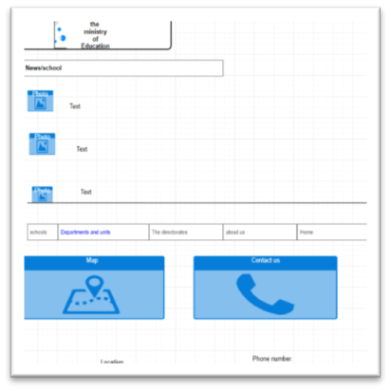
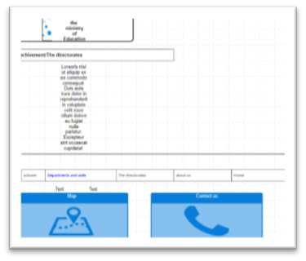

Slide 12

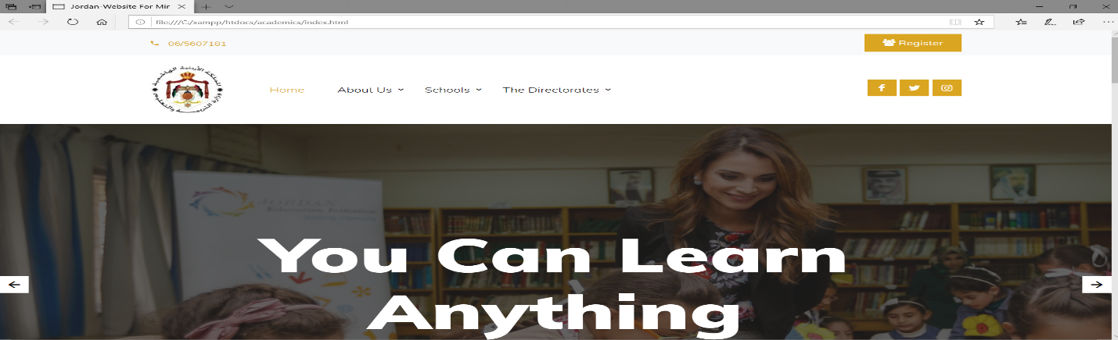
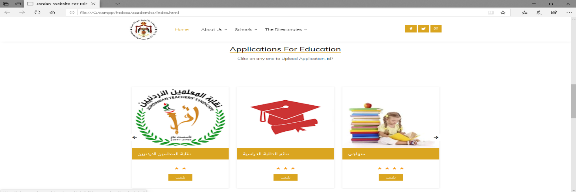
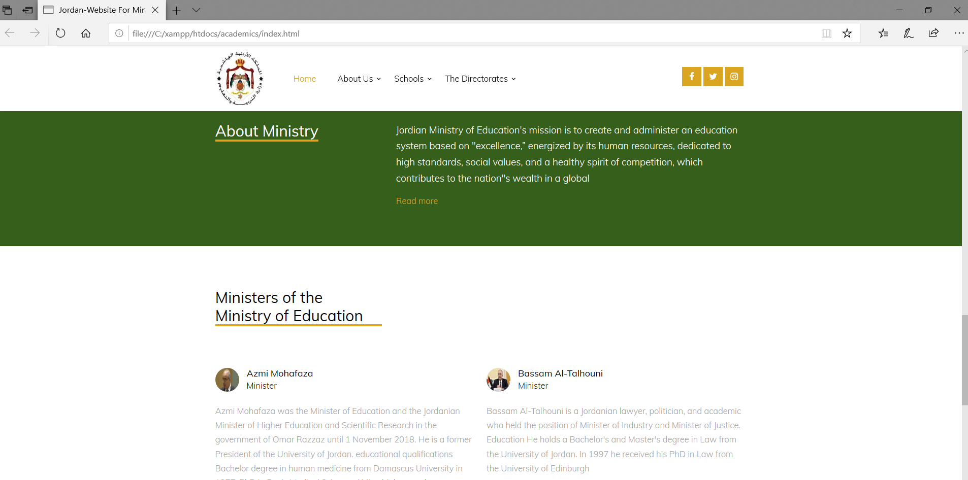
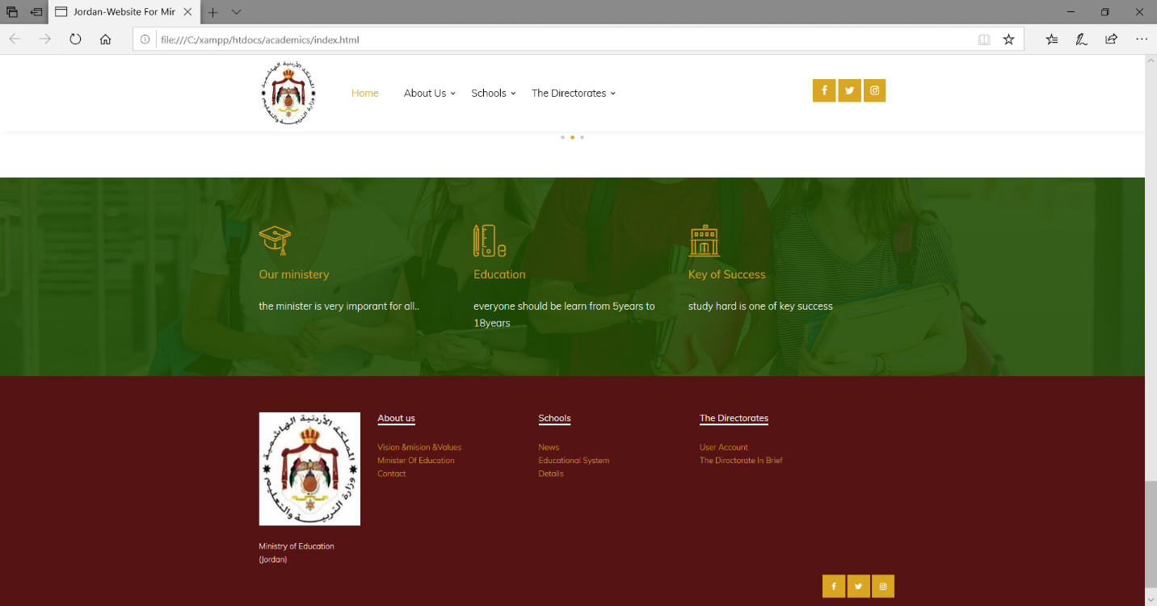
Home page:
Home page :

Slide 13
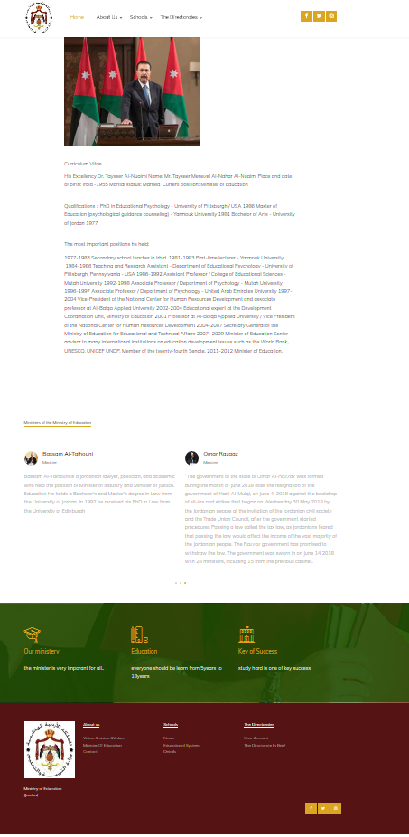
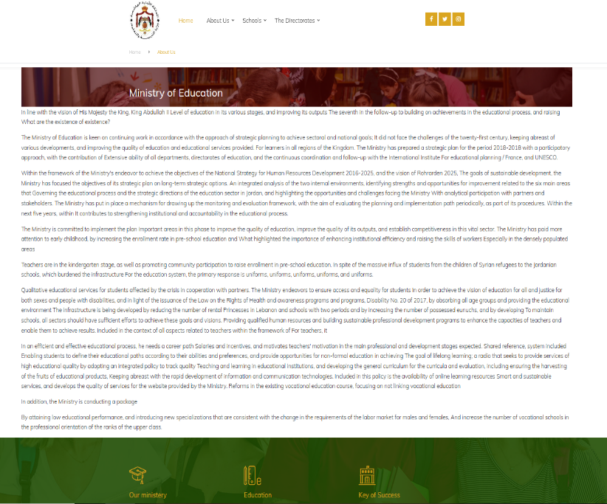
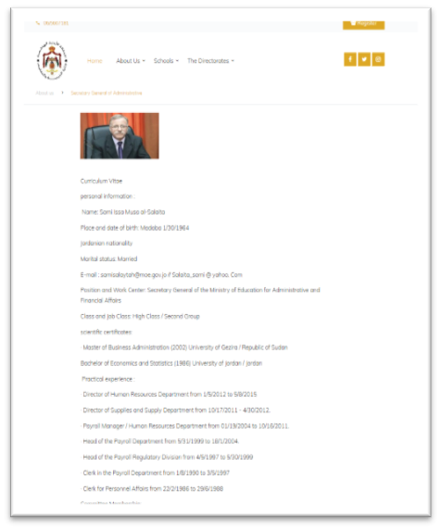

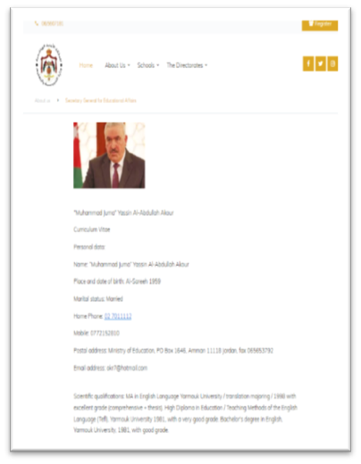
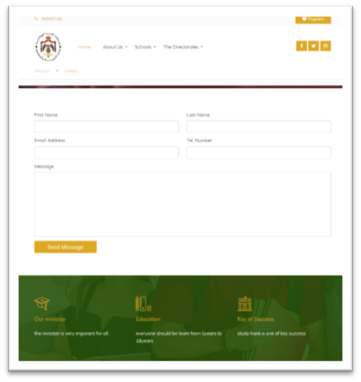

Slide 14
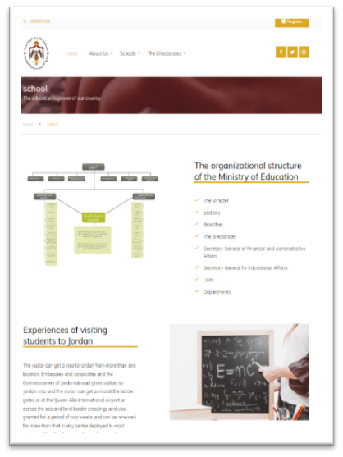
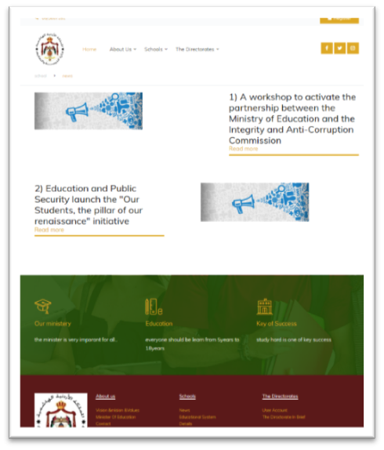

Slide 15
References:
1) Techterms.com. (2020). Server Definition. [online] Available at: https://techterms.com/definition/server [Accessed 24 Jan. 2020].
2) business.com. (2020). What is the purposes of DNS? - business.com. [online] Available at: https://www.business.com/advice/answers/question/main-purposes-of-dns/ [Accessed 24 Jan. 2020].
3) Hostwinds Guides. (2020). DNS Servers, Roles and Functions - Hostwinds Guides. [online] Available at: https://www.hostwinds.com/guide/understanding-dns-roles-function/ [Accessed 24 Jan. 2020].
4) Anon, (2020). [online] Available at: https://www.cloudflare.com/learning/dns/what-is-dns/ [Accessed 24 Jan. 2020].
5) NS1. (2020). DNS: Types of DNS Records, DNS Servers and DNS Query Types. [online] Available at: https://ns1.com/resources/dns-types-records-servers-and-queries [Accessed 24 Jan. 2020].
6) Definitions, D. and Hope, C. (2020). What is a DNS Resolver?. [online] Computerhope.com. Available at: https://www.computerhope.com/jargon/d/dns-resolver.htm [Accessed 24 Jan. 2020].
7) En.wikipedia.org. (2020). Root name server. [online] Available at: https://en.wikipedia.org/wiki/Root_name_server [Accessed 24 Jan. 2020].
8) DNS, M. (2020). What Is TLD Name Server?. [online] Dnsknowledge.com. Available at: https://www.dnsknowledge.com/whatis/tld-name-server/ [Accessed 24 Jan. 2020].
9) DNS, M. (2020). What Is Authoritative Name Server?. [online] Dnsknowledge.com. Available at: https://www.dnsknowledge.com/whatis/authoritative-name-server/ [Accessed 24 Jan. 2020].
10) Pressable Knowledge Base. (2020). DNS Record Types and Usage Explained. [online] Available at: https://kb.pressable.com/article/dns-record-types-explained/ [Accessed 24 Jan. 2020].
11) Simpledns.plus. (2020). DNS Record types. [online] Available at: https://simpledns.plus/help/dns-record-types [Accessed 24 Jan. 2020].
12) Donovan, M. (2020). What Does a Website Manager Do? | Buzz Pro Studio. [online] Buzzprostudio.com. Available at: https://www.buzzprostudio.com/website-management/what-does-a-website-manager-do [Accessed 24 Jan. 2020].
13) PURPLE ZEUS. (2020). Hardware and software. [online] Available at: https://www.purplezeus.com/hardware-and-software.html [Accessed 24 Jan. 2020].
14) Coursereport.com. (2020). Front End Development vs Back End Development: Where to Start?. [online] Available at: https://www.coursereport.com/blog/front-end-development-vs-back-end-development-where-to-start [Accessed 24 Jan. 2020].
15) Glossarytech. (2020). Front-end technologies. [online] Available at: https://glossarytech.com/terms/front_end-technologies [Accessed 24 Jan. 2020].
16) AcadGild. (2020). Top 6 Back-End Technologies and Tools You Must Know | Back End Technologies Tutorial. [online] Available at: https://acadgild.com/blog/back-end-technologies-development-tools [Accessed 24 Jan. 2020].
17) Ruby on Rails Consulting. (2020). Tools, Techniques And Material Design For Developing Any Web Page - Ruby on Rails Consulting. [online] Available at: http://codeapogee.com/tools-techniques-material-design-developing-web-page/ [Accessed 24 Jan. 2020].
18) Smashing Magazine. (2020). Responsive Web Design Techniques, Tools and Design Strategies — Smashing Magazine. [online] Available at: https://www.smashingmagazine.com/2011/07/responsive-web-design-techniques-tools-and-design-strategies/ [Accessed 24 Jan. 2020].
19) Google Books. (2020). Cybercrime. [online] Available at: https://books.google.jo/books?id=U35HVJyADlEC&pg=PT229&lpg=PT229&dq=Difference+between+online+website+creation+tools+and+made-to-order+sites&source=bl&ots=UhJwEbuJVp&sig=ACfU3U2-3Mv9q_NquP8WZpD5vis3OUA0BQ&hl=ar&sa=X&ved=2ahUKEwj_3bv51JznAhVPyoUKHXEkAc4Q6AEwDHoECA0QAQ#v=onepage&q=Difference%20between%20online%20website%20creation%20tools%20and%20made-to-order%20sites&f=false [Accessed 24 Jan. 2020].

